Slide 1

PREDICTING CUSTOMER BUYING BEHAVIOUR

Slide 2
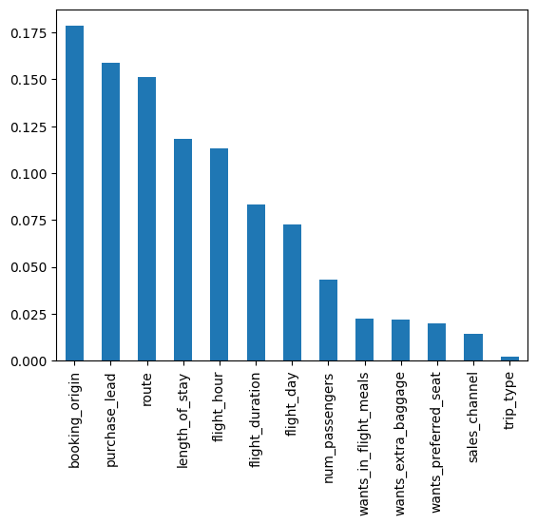
By using RandomForest classifier model, conclude that:
Top 6 feature that affect booking success:
Booking_origin
Purchase_lead
Route
Length_of_stay
Flight_hours
Flight_day
Accuracy: 0.8524
Precision: 0.6141
Recall: 0.0518

